Slide 1

By: Ashley Profit
Period : 6
1/7/11

Slide 2

The American Tract Society: A reform organization that installed the country’s first steam- powered press.
Crocket Almanacs: A mix of Humorous stories and tall tales attributed o Davy Crockett as well as meteorological and climate information
Balloon- Frame structures: Basic Frame of wooden stud’s fastened with crosspieces top and bottom.
Industrial Revolution: Social and Economic changes brought about when extensive mechanization of production systems results in a shift from home manufacturing to a large- scale factory production.
Absenteeism: Habitual failure to appear especially for work or other regular duty.
Balloon-frame structures: basic frame of wooden studs fastened with crosspieces top and bottom

Slide 3

Artisans: somebody who is skilled at a craft
Transcendentalist: a system of philosophy, especially that of Kant, that regards the processes of reasoning as the key to knowledge of reality
Philadelphia’s American Philosophical Society: Benjamin Franklin’s The American Philosophical Society Pierre Tristam.
Telegraph: a method of long-distance communication by coded electric impulses transmitted through wires
Filibuster: adventurer or pirate
Nativism: anti-immigrant feeling
Know-Nothings: when asked about their beliefs they answered “I know nothing”
Fugitive Slave Law: A law stating that it is re enforced in our constitution, returning property is legal, and that blacks couldn’t testify for themselves, couldn’t have trials, fines and jail can be given to white people who break the law.
Mormonism: A member of the Church of Jesus Christ of Latter- day Saints, founded in 1830 at La Fayette, New York, by Joseph Smith

Slide 4
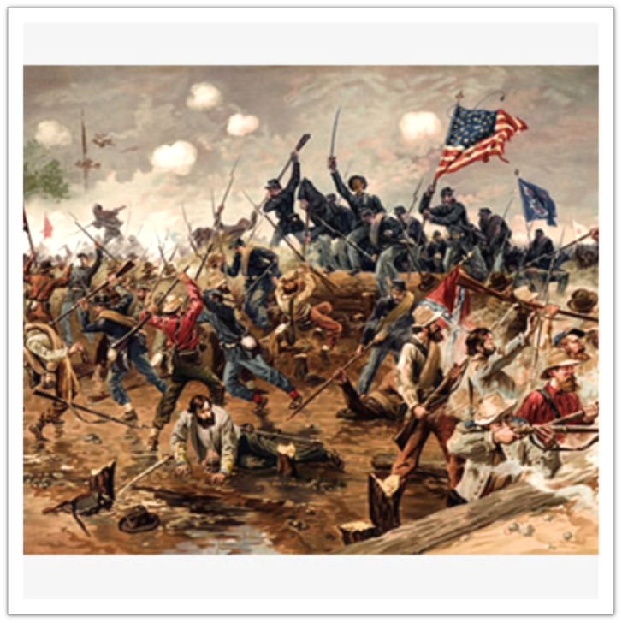
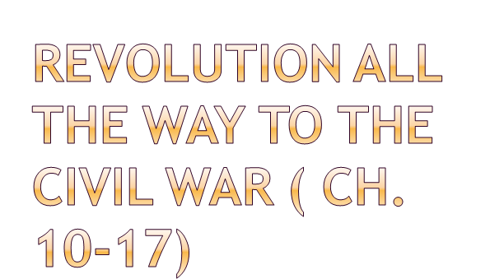
Literature
Culture development
Communication
African Americans
Artists and builders
Education
Technology
Leisure Activities
Industries

Slide 5

The Age of the Common Man (Jackson) would prove to be the period when American writers and painters found the national themes that allowed them to produce the first distinctively American literature and art.
New forms of writing “pioneered”
Poetry: unrhymed and “off-rhyme”
Short stories
Essays
Most successful novel in the mid-nineteenth century: Uncle Tom’s Cabin
Newspapers and religious journals had large readership

Slide 6

The North American Review, published in Boston, emerged as the countries most important and long- lasting magazine.
N.Y. produced the first widely recognized American writers

Slide 7

Creating the American Culture
The U.S. still looked to the Britain for values, standards, and literary offerings, and still mocked the British.
Southern Cities were much less successful in supporting culture.
Made urban cultural institutions difficult to sustain
Western cities
Emphasis on the practical was hard to distinguish from anti- intellectualism.
Eastern Cities
Philadelphia’s American Philosophical Society, founded by Benjamin Franklin in 1743 boasted a distinguished roster of scientists
South ceded cultural leadership to the North

Slide 8

Cotton Culture “ cotton was king”
In the south cotton became huge
Believed that there was no reason to invest in economically risky railroads, canals, and factories.
Urban Popular Culture
New York: largest city
Artisans replaced by immigrants
Faced 2 depressions
Drinking and fighting became popular
Gangs had to defend turf
Irish made fun of other people in theatre
Black-Face
Rebellions were common
As cities grew, people got poor and violent
Crime went up

Slide 9

Cultural Life and Social Issues
Politics and reform movements giving way to middle – class values, institutions, and ideas
“the American Renaissance”

Slide 10

The Spread of the Written word
Number of newspapers, magazines, and books grew rapidly, helping people go beyond their own community.
1826- first steam- powered press
Growth in bibles, tracts, pamphlets, and newspapers.
The rise of the newspaper paralleled the growth of interest in politics and was entertaining and popular reading.
Crocket Almanacs
Religious literature was most widely read
Woman read sentimental magazines and novels
Telegraph was invented in 1844

Slide 11

The Home Front Communication
The civil war soldiers wrote millions of letters home during the civil war more than any other war.
Letters were links between the front lines and the home front.
The letters are testaments of the troops and their stories are frequently those of slaughter and horror.

Slide 12

African Americans
Their values and attitudes, and especially their own forms of Christianity, played a vital part in shaping a culture of endurance and resistance
There were 2 key institutions of African American community life:
The Family
The African American church
They had religious ceremonies where they would gather deep into the wood where the sound of drumming, singing, and dancing could not be heard by the white ears.
Second great Awakening in the 1790’s
Free African Americans founded their own independent churches and denominations

Slide 13

Culture spread through south
Endurance and resistance
African Americans had secret contacts
Slaves were property: used, but not abused or killed
Even brutal masters knew about humanity
Family and African American church
African American Churches
white churches
- black worshipers were required o sit in the back during serviced
- they were denied any role in church governance
- They were excluded in Sunday schools
- Even in rural areas where blacks built their own churches there had to be a white pastor
Before structures were completed, they would hold services in a railroad boxcar, an outdoor arbor

Slide 14

Churches became the center not only for religious life but for many other activities that defining African American community such as:
Schools, picnics, festivals, and other political meetings
They also helped spawn a host of organizations devoted to benevolence and mutual aid, such as burial societies, Masonic lodges, temperance clubs, and trade associations.
Churches became the first social institution fully controlled by African Americans

Slide 15

Famous Artists and builders
Thomas Cole came to America from England in 1818 found great inspiration in the American landscape
Cole founded the Hudson River school of American painting
Western painters drew on the dramatic western landscape and its peoples
Their art was an important contribution to the American sense of the land and to the nation’s identity
Catlin spent 80 years among the tribes of the upper Missouri River with Indians, wanting to document them before they were gone
Wanted arouse public indignation about the plight of the western Indians
George Caleb Bingham, an accomplished genre painter, produced somewhat tidied up scenes of real-life American workers, such as flatboat men on the Missouri River
All these painters found much to record and celebrate in American life

Slide 16

Monumental neoclassical style that Jefferson had recommended for official buildings in Washington continued to be favored for public buildings elsewhere and by private concerns trying to project an imposing image, such as banks
In general American were in too much of a hurry to build for the future
Balloon-frame structures could be put up quickly, cheaply, and without help of a skilled carpenter
Consists of a basic frame of wooden studs fastened with crosspieces top and bottom

Slide 17

Education and Women Teachers
Women became involved in reform through church
Maternal association discussed the right way to raise their children
South lagged behind
Women taught
Mann thought of the grade separation
Beecher was the best female teacher
Women lived with families in the villages they taught
Schools
African Americans had a thirst for self improvement.
Free blacks managed to attend schools while southern states prohibited education for slaves.
Access to education became a central part of the meaning of freedom.
Freedmen’s Bureau was supervising nearly 3,000 schools throughout the south.

Slide 18

American Industrialization
It was the result of a series of technological changes in the textile trade
It required worked concentrating in factories and pace themselves to the rhythms of power- driven machinery.
A Revolution in Technology
Centennial Exposition of 1876: held in Philadelphia, celebrated not so much the American Revolution 100 years earlier as the industrial and technological promise of the century to come
1876: Alexander Graham Bell patented the telephone
1876: the opening of Thomas Alva Edison’s laboratory in Menlo Park, NJ
Invented the mimeograph, the multiplex telegraph, and the stock ticker.
Henry Ford (working as an electrical engineer for the Detroit Edison Co.) was already experimenting with the gasoline-burning internal combustion engine and designing his own automobile
Completion of transcontinental railroad in 1869
Added 3 more major lines in the early 1880s: Southern Pacific, Northern Pacific, and the Atchison, Topeka, and Santa Fe

Slide 19

Time, Work, and Leisure
Workers in factories sometimes took a few hours off to go berry picking or to attend to other business
For many working men, the favored spot for leisure time became the local tavern
Community- wide celebrations and casual sociability still common in rural areas began to be replaced in cities by spectator sports- horse racing, boxing, and baseball
Popular entertainments: plays, operas, minstrel shows, concerts, and circuses.
Played games such as quoits and nine pins

Slide 20

The Ghost Dance
1888
The Paiute prophet Wovoka was ill with scarlet fever and he had a vision during a total eclipse of the sun\
In the vision, the Creator told him that if the Indian peoples learned to love each other, they would be granted a special place in the afterlife
The Creator also gave him the Ghost Dance

Slide 21

Industries
Some industries suffered during this time period:
- Textile manufacturers could not get cotton
- Shoe factories that had made cheap shoes for slaves were without market.
Some industries boomed during the time period:
- Bookmaking, shipbuilding, and the manufacture of woolen goods such as blankets and uniforms.
Agricultural goods were in great demand
- Farming was promoted
- The McCormick brothers grew rich from sales of their reapers.

Slide 22

Ralph Waldo Emerson
He was the star of the lyceum circuit, a lecture network that sent speakers on cultural subjects to all parts of the country
Gave more than 1,500 lectures in twenty states between 1833 and 1860
“The American Scholar” is his most famous lecture that carried a message of cultural self- sufficiency that Americans were eager to hear.
James Fennimore Cooper
Wrote the Leather Stocking novels (1826) that achieved wide success in both America and Europe.
His Novels featured a heroic frontiersman, Natty Bumppo
They established the long American experience of west ward expansion.

Slide 23

Thomas Cole
February 1, 1801 – February 11, 1848
English-born American artist
regarded as the founder of the Hudson River School, an American art movement that flourished in the mid-19th century.
Cole's Hudson River School, as well as his own work, was known for its realistic and detailed portrayal of American landscape and wilderness, which feature themes of romanticism and naturalism.
Henry Ward Beecher
June 24, 1813 – March 8, 1887
a prominent Congregationalist clergyman, social reformer, abolitionist, and speaker in the mid to late 19th century.
An 1875 adultery trial in which he was accused of having an affair with a married woman was one of the most notorious American trials of the 19th century.

Slide 24

Harriet Beecher Stowe
(June 14, 1811 – July 1, 1896) was an American abolitionist and author.
Her novel Uncle Tom's Cabin (1852) depicted life for African Americans under slavery; it reached millions as a novel and play, and became influential .
It energized anti-slavery forces in the American North, while provoking widespread anger in the South.
She wrote more than 20 books, including novels, three travel memoirs, and collections of articles and letters. She was influential both for her writings and her public stands on social issues of the day.
Elijah Lovejoy
the son of a Congregational minister
After graduating from Waterville College in 1826, he moved to St. Louis, Missouri, where he established a school before attending the Princeton Theological Seminary.
In 1834 Lovejoy became the pastor of the Presbyterian Church in St. Louis. He started a religious newspaper, the St. Louis Observer, where he advocated the abolition of slavery.
- His press was destroyed by a white mob.
Lovejoy moved to Alton, Illinois where he became an active member of the local Anti-Slavery Society. He also began editing the Alton Observer and continued to advocate the end of slavery.

Slide 25

1. Who were some popular writers during the early 1800’s?
Washington Irving
James Fennimore Cooper
Ralph Waldo Emerson
A and B
B and C
2. A reform organization that installed the country’s first steam- powered press was?
Industrialization
Press society
The American Tract Society
First steam society
3. Who was a popular lecturer during the 1830’s- 1860?
James Fennimore Cooper
Ralph Waldo Emerson
Davy Crockett
Jackson
4. When was the first steam- powered press invented?
1830
1851
1826
1842

Slide 26
5. What was the most important form of communication during this time period that just got introduced?
Newspapers
Media
Telegraphs
Cable lines
6. What magazine emerged as the country’s most important and long lasting magazine?
The north American Review
The U.S. market
Times review
Lovely Bones
7. What was the popular culture during this time period?
Sports
Literature
Crafts
Fashion
8. What type of literature was widely read?
Religious
Educational
Statistical
Cultural

Slide 27
9.Hard working factory working men did what on their leisure time?
Local tavern
Berry Picking
Attended other business related things
All of the above
10. What plantation grew majorly in the south?
Tobacco
Sugar
Cotton
Coffee
11. What city was the largest city?
New York
Chicago
San Francisco
Los Angeles
12. What Major invention was invented to better communication?
Telephone
Telegraph
Steam engine
Histogram

Slide 28
13. During the African American community what was important?
Communication
Patience
Endurance and resistance
education
14. What replaced immigrants?
Artisans
Indentured servants
Midwives
Skilled workers
15. Transportation spread majorly especially in the North because of:
Canals
Railroads
Roads
All of the above
16. What did the gangs have to protect?
Money
Their families
Turf
themselves

Slide 29
17. Who became the first factory workers in the North?
Middle daughters
Artisans
Irish Workers
African Americans
18. Who was a famous artist during this time?
Thomas Cole
Picasso
Michael de Angelo
Michael del mayo may
19. Who was a major transcendentalist who wrote a book called Walden?
Shakespeare
Raleigh
Marlowe
Thoreau
20. For literary input who did America look to still?
Britain
France
Italy
Spain

Slide 30
21. Who wrote Uncle Tom’s Cabin?
Lincoln
Harriet Beecher Stowe
Daniel Webster
Gabriel Prosser
22. The major forms of writing were?
Poetry
Short Stories
Essays
All the Above
23. Nativism is______?
A anti- immigrant feeling
The person on their home land
An Indian
Support in your country
24. What became the first social institution fully controlled by African Americans?
Hospitals
Farms
Churches
Schools

Slide 31
25. Who wrote newspapers against slavery?
Elijah Lovejoy
Harriet Beecher Stowe
Lincoln
Jackson
26. The Paiute prophet Wovoka was ill with scarlet fever and he had a vision during a total eclipse of the sun, what was this called?
Lunar
Ghost Dance
Sun God praise
Light Dance
27. A filibuster was?
Adventurer or pirate
Farmer
Slave
explorer
28. Which of these was a poplar technology of the 1800’s?
Stock ticker
Telegraph
Telephone
All of the above are correct

Slide 32
29. Politics and reform movements giving way to what social class?
Middle
Upper
Lower
There wasn’t one class that came up
30. What was not an industry that boomed during this time period?
Bookmaking
Shipbuilding
manufacture of woolen goods
Farming

Slide 33

1. d
2. c
3. a
4. c
5. c
6. a
7. b
8. a
9. d
10. c
11. a
12. b
13. c
14. a
15. d
16. c
17. a
18. a
19. d
20. a
21. b
22. d
23. a
24. c
25. a
26. b
27. a
28. d
29. a
30. d

Slide 34

Faragher, J, Buhle, M, Czitrom, D, & Armitage, S. (2000). Out of many. Upper Saddle River, New Jersey: Prentice Hall.
(n.d.). Retrieved from http://en.wikipedia.org/wiki/Main_Page

